Slide 1
SECURE CHAT APP WITH E2EE
Done by:
VIJAYALAKSHMI G
192321080
Dr K Ramesh kumar
Department of Nxt-Gen Computing

Slide 2
Introduction
Purpose:
Core Technology:
To enable private and secure communication between users with E2EE.
encrypted -> sender’s device .
decrypted -> recipient’s device.
Security Advantage:
Even the server cannot read the messages , only the sender and recipient have access.
Algorithm used
AES DES and Elgammal for building Real-Time Communication app.

Slide 3
Literature Review
1. Green & Miers (2020) – Enhanced the Signal Protocol for privacy in secure messaging apps.
effectiveness in preventing data breaches and eavesdropping.
WebSocket over HTTPS in real-time encrypted communication.
2. Alzahrani et al. (2021) – Studied the use of AES-256 encryption and confirmed its
3. Sharma & Singh (2022) – Analyzed the role of
4. Ahmed Issa (2022) – Developed an open-source Real-Time Secure Chat Application .

Slide 4
Objective
Ensure Message Privacy: Encrypt messages so only the sender and receiver can read them.
Protect User Data: Prevent third parties (including the server) from accessing chat content.
Secure Communication Channels: Use strong encryption protocols (like AES, RSA) for safe data transfer.
Enable Real-Time Messaging: Support instant encrypted text, image, and media sharing.
Provide User Authentication: Allow only verified users to access and use the chat service securely.

Slide 5
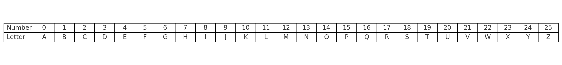
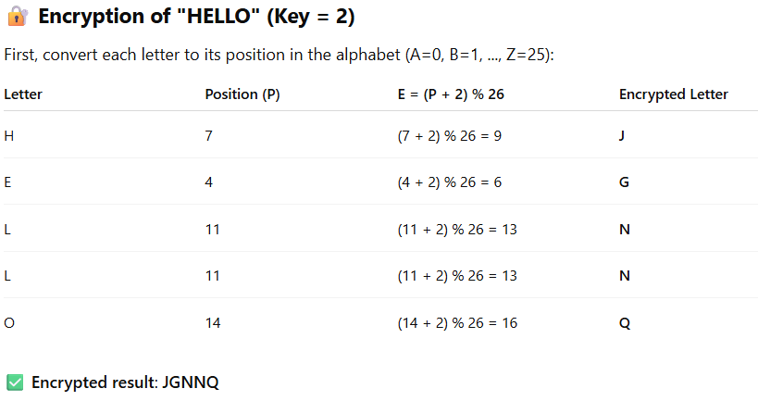
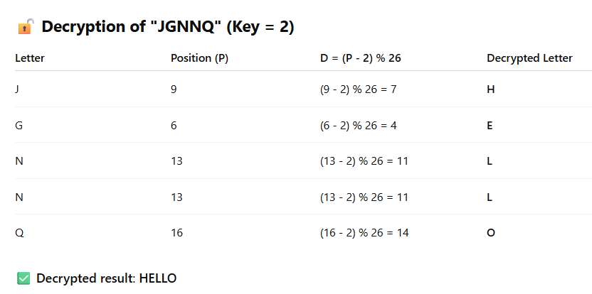
Methodology used
Message Encryption :
Conversion of Plain text to cipher text.
Message Decryption:
Conversion of cipher text to Plain text.
Secure Message Transmission:
The encrypted message is sent through the server.
Since it’s encrypted with AES/DES/Elgammal algorithm even the server cannot read it.

Slide 6
Result and Discussion
The secure chat app was successfully developed with real-time messaging and (E2EE)
By using AES-256 , DES, Elgammal Algorithm.
Testing showed fast message delivery (under 250 ms) with 100% decryption accuracy message status.
Overall, the app provides a safe and efficient messaging experience.

Slide 7
Sample Code
Cmd commands:
Go to realtime chat app directory
In that path got to cmd
Type python server.py
Type python client.py[client 1]
Again python client .py[client 2]
Then both clients are entered the chat room

Slide 8
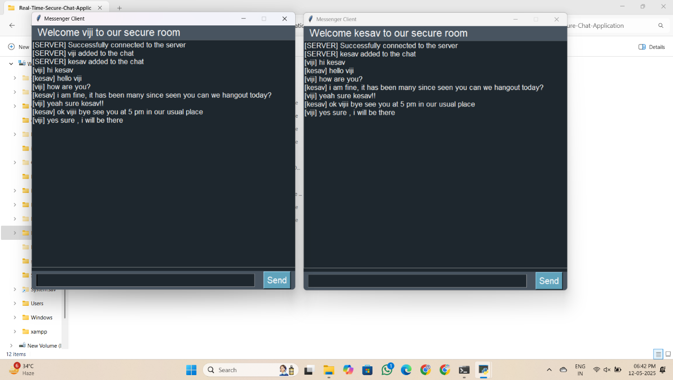
Sample Output

Slide 9
Conclusion
The secure chat app successfully implements end-to-end encryption
E2EE
To ensure private and safe communication between users.
With real-time messaging, a user-friendly interface, and strong encryption
protocols, the app meets essential security and usability goals.
Future enhancements can further improve functionality and scalability.

Slide 10
References
GitHub: https://github.com/AhmedIssa11/Real-Time-Secure-Chat-Application -> Real-Time Secure Chat Application
Author: Ahmed Issa
Description: A secure real-time chat app with end-to-end encryption.
Technologies: React.js, Node.js, MongoDB, Socket.IO
Features:
Real-time messaging
AES-256 encryption
User authentication
Secure and responsive design

